Slide 1
NEXT-GENERATION DEFENSE SECURITY: BLOCKCHAIN, IOT, DIGITAL TWIN, AND FACE RECOGNITION-BASED SMART MONITORING SYSTEM
GUIDED BY,
Mrs.R.ANBARASI M.E.,
ASSISTANT PROFESSOR/CSE,
NELLIANDAVAR INSTITUTE
OF TECHNOLOGY.
PRESENTED BY,
RANJITH K -(815821104018)
SOUNDHARYA S -(815821104025)
PRIYADHARSHINI T -(815821104709)
SAKKARABANI S -(815821104711)

Slide 2
ABSTRACT
This study presents a next-generation defense security framework that leverages Blockchain, Internet of Things (IoT), Digital Twin technology, and Face Recognition to deliver a comprehensive smart monitoring system.
Blockchain ensures secure, immutable data transactions, enhancing trust and integrity in defense networks. IoT devices facilitate real-time data collection and situational awareness, while Digital Twin technology creates virtual replicas of physical assets to simulate and predict potential threats.
Face recognition further strengthens security by enabling precise identification and access control. Together, these technologies synergize to form a resilient system capable of detecting, analyzing, and responding to potential threats with unprecedented efficiency.

Slide 3
OBJECTIVES
Develop a robust monitoring system that leverages advanced technologies to improve situational awareness and threat detection.
Combine Blockchain, IoT, Digital Twin, and Face Recognition technologies into a unified framework for seamless operations and data synergy.
Utilize Blockchain for secure, immutable storage of sensitive defense data and to prevent unauthorized access or tampering.

Slide 4
LITERATURE REVIEW
TITLE | AUTHOR NAME AND YEAR | TECHNIQUES | MERITS | DEMERITS
Emerging Technologies And National Security: The Impact Of Iot In Critical Infrastructures Protection And Defence Sector | P. Pătraşcu, 2021 | Artificial intelligence, Internet of Things, Big Data, robots, drones | Implemented in critical infrastructures | Security is less
Strengthening The Defence Industry's Independence Through The Internet Of Things In The Manufacturing Sector: A Review | Jonathan Ernest Sirait, 2023 | Qualitative method | Implementation of digitalization through IoT | Does not support in real time environments
Wearable Computing for Defence Automation: Opportunities and Challenges in 5G Network | Pradip kumar sharma, 2020 | Wearable computing | monitor the soldier’s activities and state of health | Cost is high
Cognitive Framework of Food Quality Assessment in IoT-inspired Smart Restaurants | Munish Bhatia, 2022 | Bayesian Modelling Technique. | Quality assessment of food over real-time parameters | Probability based measurements
APT Adversarial Defence Mechanism for Industrial IoT Enabled Cyber-Physical System | SAFDAR HUSSAIN JAVED, 2023 | Graph Attention Network (GAN) | Detecting complex APT malware | Difficult to implement in Multiple infrastructures

Slide 5
EXISTING SYSTEM
Traditional surveillance systems, including CCTV cameras and motion sensors, are widely used to monitor activities and record incidents for post-event analysis.
Emerging technologies like IoT have introduced real-time data collection and situational awareness through interconnected sensors and devices. However, these systems often suffer from vulnerabilities like cyberattacks and scalability issues due to their centralized architectures.
Modular data analysis stack called Life streams to investigate and assess individual data streams.

Slide 6
DISADVANTAGES
Systems lack real-time threat detection
Rely heavily on human intervention
And are prone to tampering and inefficiencies
Do not integrate with broader security frameworks.

Slide 7
PROPOSED SYSTEM
Proposed integrated system offers real-time monitoring, secure data management, predictive analytics, and advanced access control, ensuring a robust and scalable defense solution
Implements a decentralized ledger to store sensitive defense data securely, ensuring immutability and protection against cyberattacks using SHA-256 in Block chain technology
Integrates advanced face recognition algorithm named as Grassmann algorithm to provide accurate identity verification and prevent unauthorized access to sensitive areas.

Slide 8
GRAASSMAN ALGORITHM
The Grassmann algorithm operates on the concept of representing facial images as subspaces (points) on a Grassmann manifold.
1: Face Detection – Detect faces in input images using cameras or sensors.
2: Preprocessing – Normalize lighting, align faces, and remove background noise.
3: Feature Extraction – Identify facial landmarks like eyes, nose, and mouth.
4: Subspace Formation – Represent features as vectors in high-dimensional space.
5: Grassmann Mapping – Project vectors onto the Grassmann manifold (subspace representation).
6: Similarity Computation – Calculate distances between subspaces (e.g., geodesic or projection).
7: Classification/Matching – Match against stored templates and verify identity.

Slide 9
SHA 256 BITS ALGORITHM
SHA-256 is a cryptographic hash function used to ensure data integrity. It transforms input data into a fixed 256-bit hash.
Message Preprocessing
Convert input to binary.
Pad message to be a multiple of 512 bits.
Parse into Blocks – Split padded message into 512-bit blocks.
Initialize Hash Values – Use eight predefined 32-bit constants.
Prepare Message Schedule – Expand the 512-bit block into 64 32-bit words.
Compression Function
Loop through 64 rounds with logical operations and constants.
Update working variables a–h.
Output Final Hash – Combine updated variables into a 256-bit output.

Slide 10
ADVANTAGES
Enhanced Security and Data Integrity
Real-Time Monitoring and Threat Detection
Accurate Identity Verification
Scalability and Adaptability
Decentralized and Transparent Operations

Slide 11
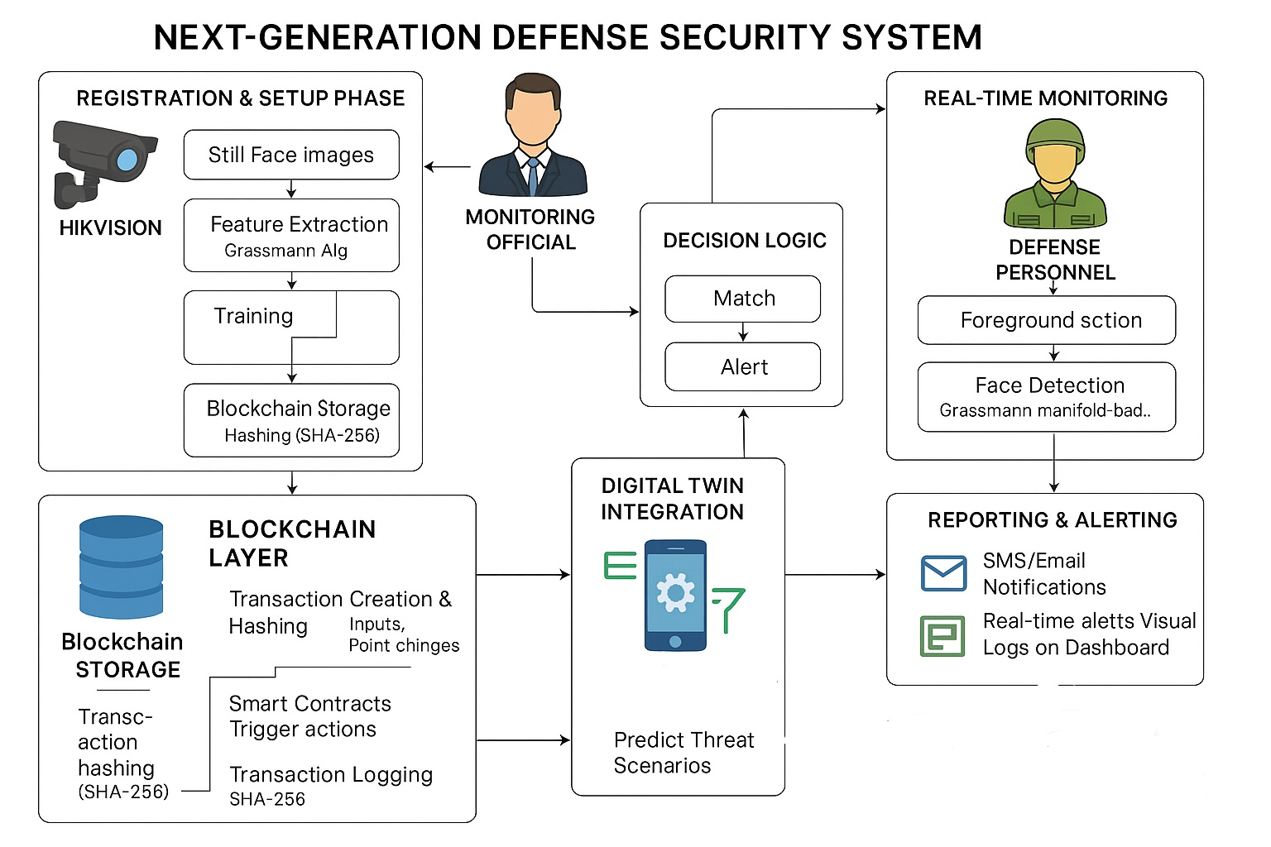
SYSTEM ARCHITECTURE

Slide 12
MODULES
Defense data security framework
Camera based face registration module
Face Recognition and Access Control
Block chain based transactions
Reporting system

Slide 13
MODULES
DEFENSE DATA SECURITY FRAMEWORK:
The Defense Data Security Framework proposed in this system integrates advanced technologies to protect sensitive data from unauthorized access, tampering, and cyberattacks while ensuring the reliability and integrity of operations in defense scenarios.
The framework leverages the strengths of Blockchain technology and other supportive mechanisms to provide a secure, scalable, and resilient solution for managing defense data.
In this module, design the framework for defense professional and monitoring officials.

Slide 14
MODULES
CAMERA BASED FACE REGISTRATION MODULE:
Utilizes high-resolution cameras to detect and capture facial images in real time.
Employs pre-processing techniques (e.g., normalization and background removal) to enhance image quality and reduce noise.
Facial images are represented as points on the Grassmann manifold, a mathematical space that allows effective processing of high-dimensional facial data.
Key facial features (e.g., eyes, nose, mouth) are identified and extracted

Slide 15
MODULES
FACE RECOGNITION AND ACCESS CONTROL:
The Face Recognition and Access Control Module is a critical component of the defense security system, providing robust and efficient biometric authentication for secure access to sensitive areas and systems.
Once a face is detected, key facial features (e.g., eyes, nose, mouth) are extracted, normalized, and matched into the system for future recognition
During authentication, the system compares real-time captured face images with registered data. A similarity score is computed based on predefined thresholds, allowing the system to verify or deny access.

Slide 16
MODULES
BLOCK CHAIN BASED TRANSACTIONS:
In a Blockchain-based system, transactions are recorded in a distributed ledger across multiple nodes, preventing a single point of failure and reducing voulnerability to attacks. Each transaction is confirmed by the network, ensuring its authenticity.
Once a transaction is recorded on the Blockchain, it is nearly impossible to alter or delete. Each block is cryptographically linked to the previous one, creating a secure chain of transactions.
This immutability ensures that defense-related data, such as access logs, biometric information, and sensor data, cannot be tampered with, ensuring accuracy and reliability.
In this module, defense professional face data and records are stored as supply chain using hash algorithm

Slide 17
MODULES
Reporting system:
The Reporting System in the proposed defense security framework plays a crucial role in providing comprehensive, real-time insights into the security status, incidents, and system operations.
It enables timely reporting, monitoring, and analysis of activities across various components of the system, such as access control, surveillance and Blockchain transactions. The system is designed to facilitate decision-making, enhance operational transparency, and improve accountability.
Access notification can be send to monitoring official in terms of SMS alert and also reports are forward as Email notification

Slide 18
SYSTEM REQUIREMENTS
HARDWARE REQUIREMENTS
Processor : Intel processor 2.6.0 GHZ
RAM : 4 GB
Hard disk : 160 GB
Compact Disk : 650 Mb
Keyboard : Standard keyboard
Monitor : 15 inch color monitor

Slide 19
SYSTEM REQUIREMENTS
SOFTWARE REQUIREMENTS
Server Side : Python 3.7.4(64-bit) or (32-bit)
Client Side : HTML, CSS, Bootstrap
IDE : Flask 1.1.1
Back end : MySQL 5.
Server : WampServer 2i
OS : Windows 10 64 –bit

Slide 20
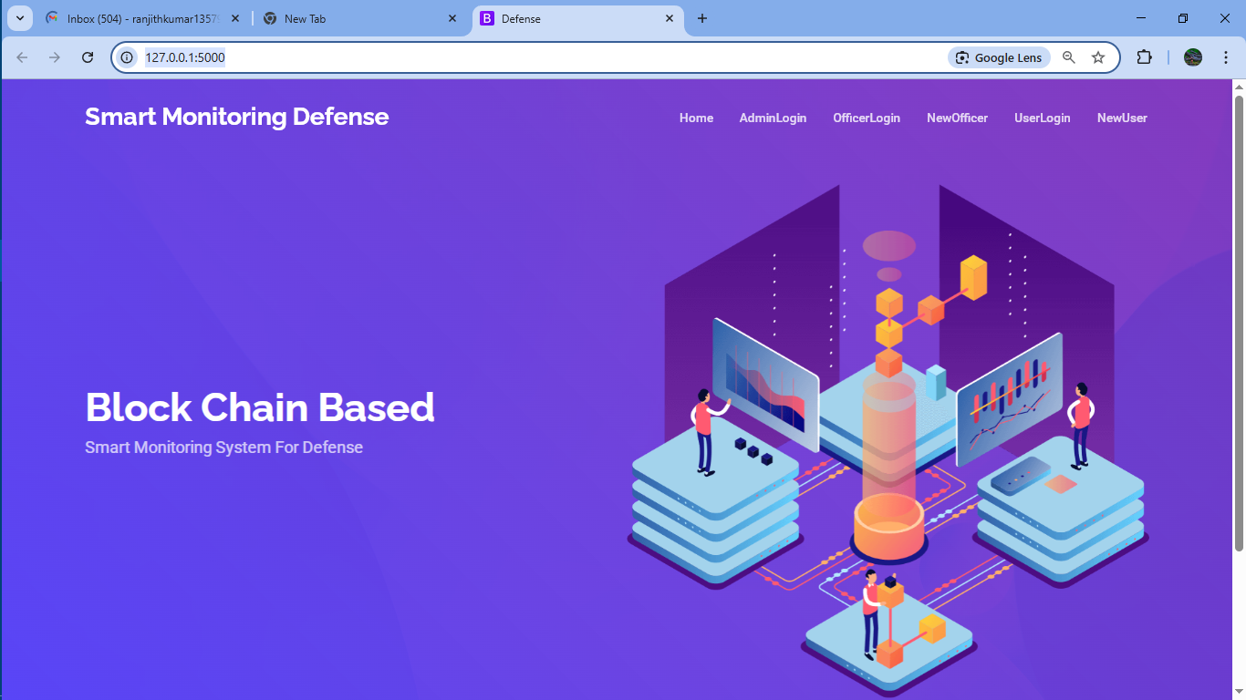

Slide 21
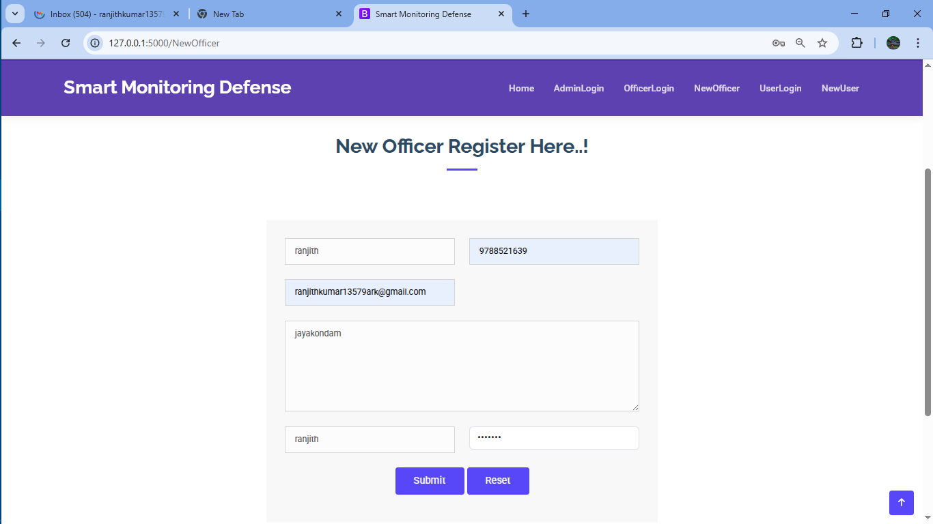

Slide 22
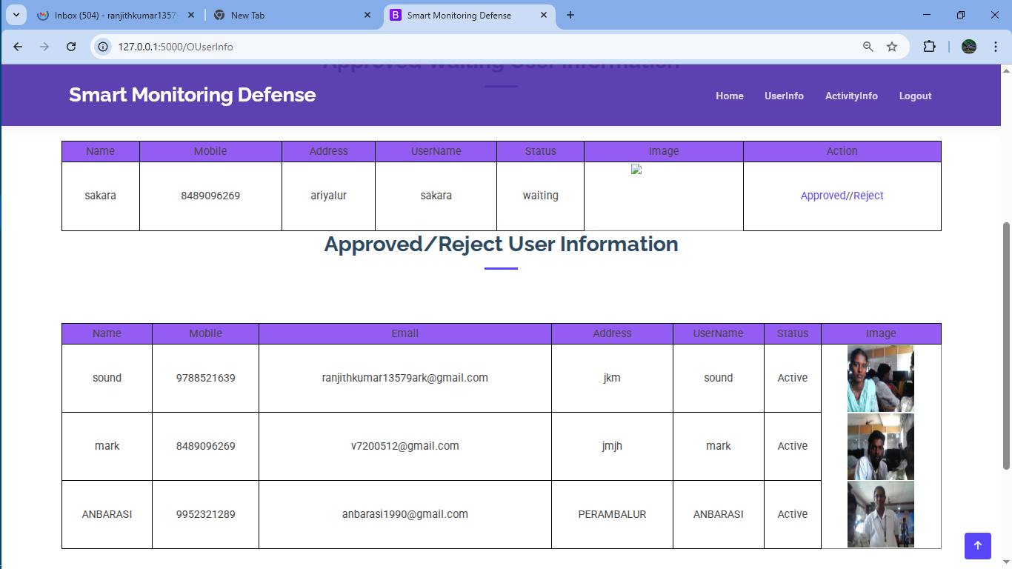

Slide 23
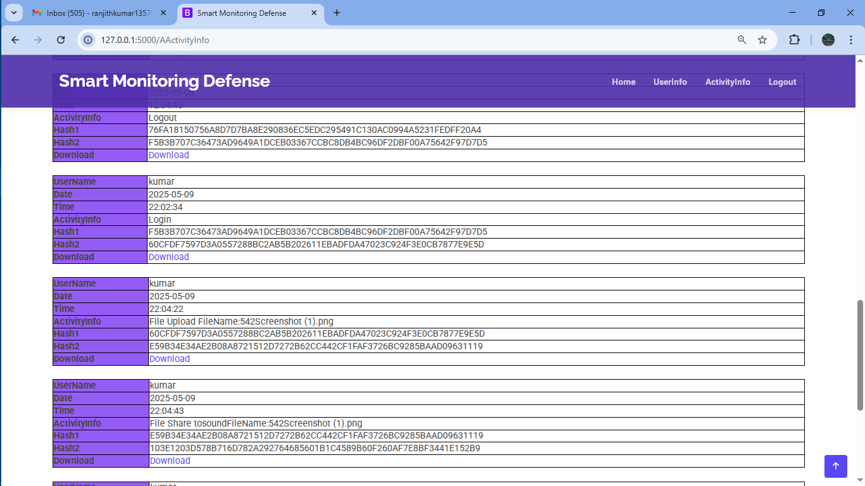

Slide 24
CONCLUSION
The proposed Next-Generation Defense Security System leveraging Blockchain, IoT, Digital Twin technology, and Face Recognition provides a comprehensive, robust, and scalable solution to modern security challenges.
By integrating these cutting-edge technologies, the system enhances the efficiency, accuracy, and reliability of monitoring, access control, and data security processes within defense environments.
The Reporting System ensures comprehensive oversight, generating real-time insights and logs for better decision-making, incident tracking, and overall operational transparency.
By combining these technologies, the system not only secures sensitive data but also fosters a proactive, real-time defense environment that is adaptable to evolving threats and capable of scaling with growing security needs.

Slide 25
FUTURE WORK
Further integration of AI and machine learning algorithms can enhance real-time threat prediction, anomaly detection, and decision-making.
Machine learning models could analyze historical data from IoT sensors, access logs, and surveillance footage to identify patterns and predict potential security breaches before they occur.
Incorporating VR/AR for system simulations and training could provide operators with immersive experiences for decision-making in critical situations.

Slide 26
REFERENCES
Bhatia, Munish, and Ankush Manocha. "Cognitive framework of food quality assessment in IoT-inspired smart restaurants." IEEE Internet of Things Journal 9.9 (2020): 6350-6358.
Javed, Safdar Hussain, et al. "APT adversarial defence mechanism for industrial IoT enabled cyber-physical system." IEEE Access 11 (2023): 74000-74020.
Pătraşcu, Petrișor. "Emerging technologies and National Security: The impact of IoT in critical infrastructures protection and defence sector." Land Forces Academy Review 26.4 (2021): 423-429.
Sirait, Jonathan, Hazen Alrasyid, and Nadia Aurora Soraya. "Strengthening The Defense Industry's Independence Through The Internet Of Things In The Manufacturing Sector: A Review." International Journal of Science, Technology & Management 4.2 (2023): 335-340.
Sharma, Pradip Kumar, et al. "Wearable computing for defence automation: Opportunities and challenges in 5G network." IEEE Access 8 (2020): 65993-66002.

Slide 27
THANK YOU!

